Slide 1
Latent variable models
4: Ordered categorical indicator variables

Slide 2
Today’s topics
Binary items
least-squares type estimation (factor analysis)
ML estimation (IRT)
1PL (Rasch) vs. 2PL model: Same or different loadings between items?
Generalization to ordered-categorical items

Slide 3
Ordered categorical indicator variables
Up till now, endogenous variables have always been continuous
Often variables in psychology are (ordered) categorical
Exogenous ordered categorical variables:
Code as (multiple) dummy (0-1) variables
Comparable to having binary predictors in linear regression
Endogenous variables: Need different model
Comparable to having binary or ordered categorical response variable in regression: Have to use e.g., logistic or probit regression

Slide 4
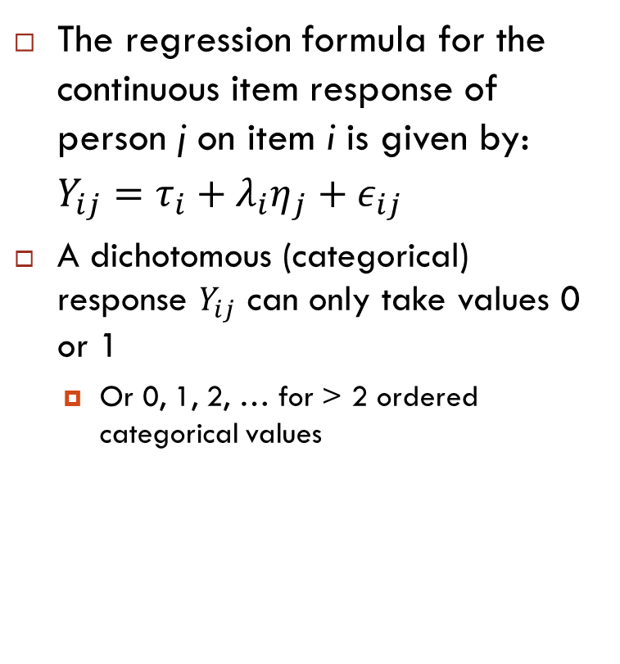
Ordered categorical indicator variables
The regression formula for the continuous item response of person j on item i is given by: $Y_{ij}=τ_{i}+λ_{i}η_{j}+ε_{ij}$
A dichotomous (categorical) response $Y_{ij}$ can only take values 0 or 1
Or 0, 1, 2, … for > 2 ordered categorical values

Slide 5







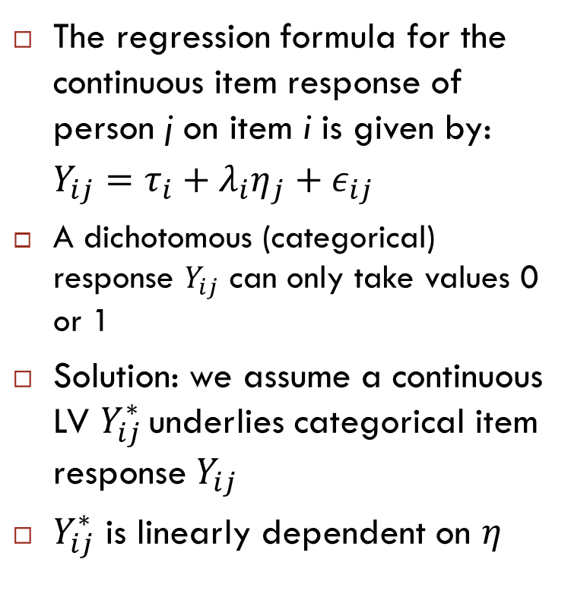










Ordered categorical indicator variables
Continuous
variables
Categorical
variables
The regression formula for the continuous item response of person j on item i is given by: $Y_{ij}=τ_{i}+λ_{i}η_{j}+ε_{ij}$
A dichotomous (categorical) response $Y_{ij}$ can only take values 0 or 1
Solution: we assume a continuous LV $Y_{ij}^{∗}$ underlies categorical item response $Y_{ij}$
$Y_{ij}^{∗}$ is linearly dependent on $η$
$$y_{1}^{∗}$$
$$y_{1}$$
$$λ_{1}$$
$$σ_{ε_{1}}$$
$$ε_{1}$$
$$η$$
$$λ_{2}$$
$$y_{2}^{∗}$$
$$σ_{η}$$
$$y_{2}$$
$$σ_{ε_{2}}$$
$$ε_{2}$$
$$λ_{3}$$
$$y_{3}^{∗}$$
$$y_{3}$$
$$σ_{ε_{3}}$$
$$ε_{3}$$

Slide 6
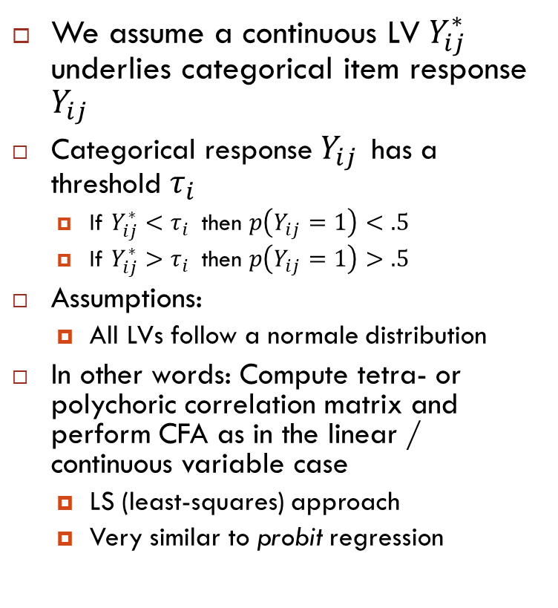
Ordered categorical indicator variables
We assume a continuous LV $Y_{ij}^{∗}$ underlies categorical item response $Y_{ij}$
Categorical response $Y_{ij}$ has a threshold $τ_{i}$
If $Y_{ij}^{∗}<τ_{i}$ then $p\left(Y_{ij}=1\right)<.5$
If $Y_{ij}^{∗}>τ_{i}$ then $p\left(Y_{ij}=1\right)>.5$
Assumptions:
All LVs follow a normale distribution
In other words: Compute tetra- or polychoric correlation matrix and perform CFA as in the linear / continuous variable case
LS (least-squares) approach
Very similar to probit regression
$$y_{1}^{∗}$$
$$y_{1}$$
$$λ_{1}$$
$$σ_{ε_{1}}$$
$$ε_{1}$$
$$η$$
$$λ_{2}$$
$$y_{2}^{∗}$$
$$σ_{η}$$
$$y_{2}$$
$$σ_{ε_{2}}$$
$$ε_{2}$$
$$λ_{3}$$
$$y_{3}^{∗}$$
$$y_{3}$$
$$σ_{ε_{3}}$$
$$ε_{3}$$

Slide 7
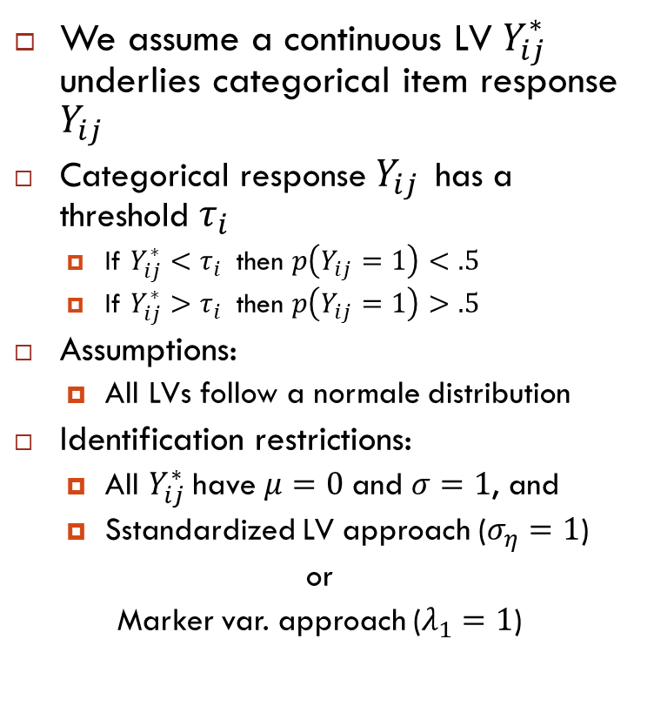
Ordered categorical indicator variables
We assume a continuous LV $Y_{ij}^{∗}$ underlies categorical item response $Y_{ij}$
Categorical response $Y_{ij}$ has a threshold $τ_{i}$
If $Y_{ij}^{∗}<τ_{i}$ then $p\left(Y_{ij}=1\right)<.5$
If $Y_{ij}^{∗}>τ_{i}$ then $p\left(Y_{ij}=1\right)>.5$
Assumptions:
All LVs follow a normale distribution
Identification restrictions:
All $Y_{ij}^{∗}$ have $μ=0$ and $σ=1$, and
Sstandardized LV approach ($σ_{η}=1$)
or
Marker var. approach ($λ_{1}=1$)
$$y_{1}^{∗}$$
$$y_{1}$$
$$λ_{1}$$
$$σ_{ε_{1}}$$
$$ε_{1}$$
$$η$$
$$λ_{2}$$
$$y_{2}^{∗}$$
$$σ_{η}$$
$$y_{2}$$
$$σ_{ε_{2}}$$
$$ε_{2}$$
$$λ_{3}$$
$$y_{3}^{∗}$$
$$y_{3}$$
$$σ_{ε_{3}}$$
$$ε_{3}$$

Slide 8
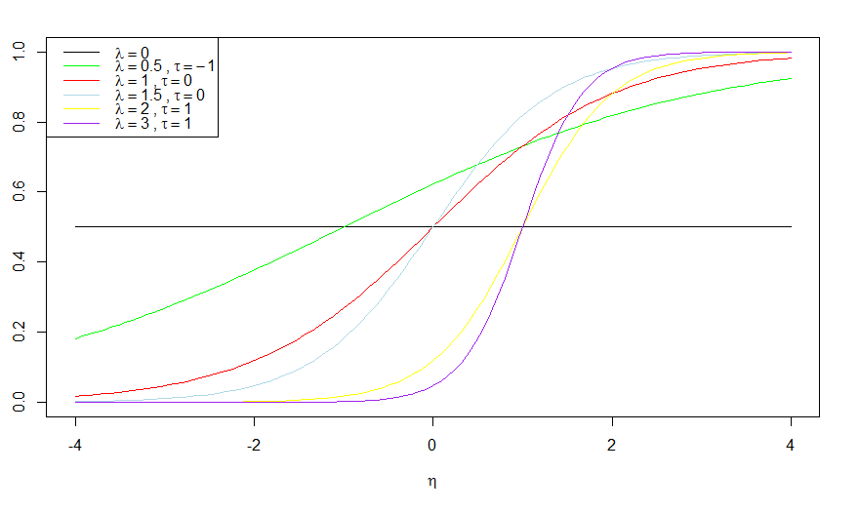


Item characteristic curves (ICCs)
To get from latent $η$ to observed dichotomous response $Y_{ij}$:
$$p\left(Y_{ij}=1 | η\right)=\frac{e^{λ_{i}(η_{j}−τ_{i})}}{1+e^{λ_{i}(η_{j}−τ_{i})}}$$
$p$($Y_{ij}=1$)

Slide 9
Examples and exercises
Example 6.2 - part I
Exercise 6.1

Slide 10
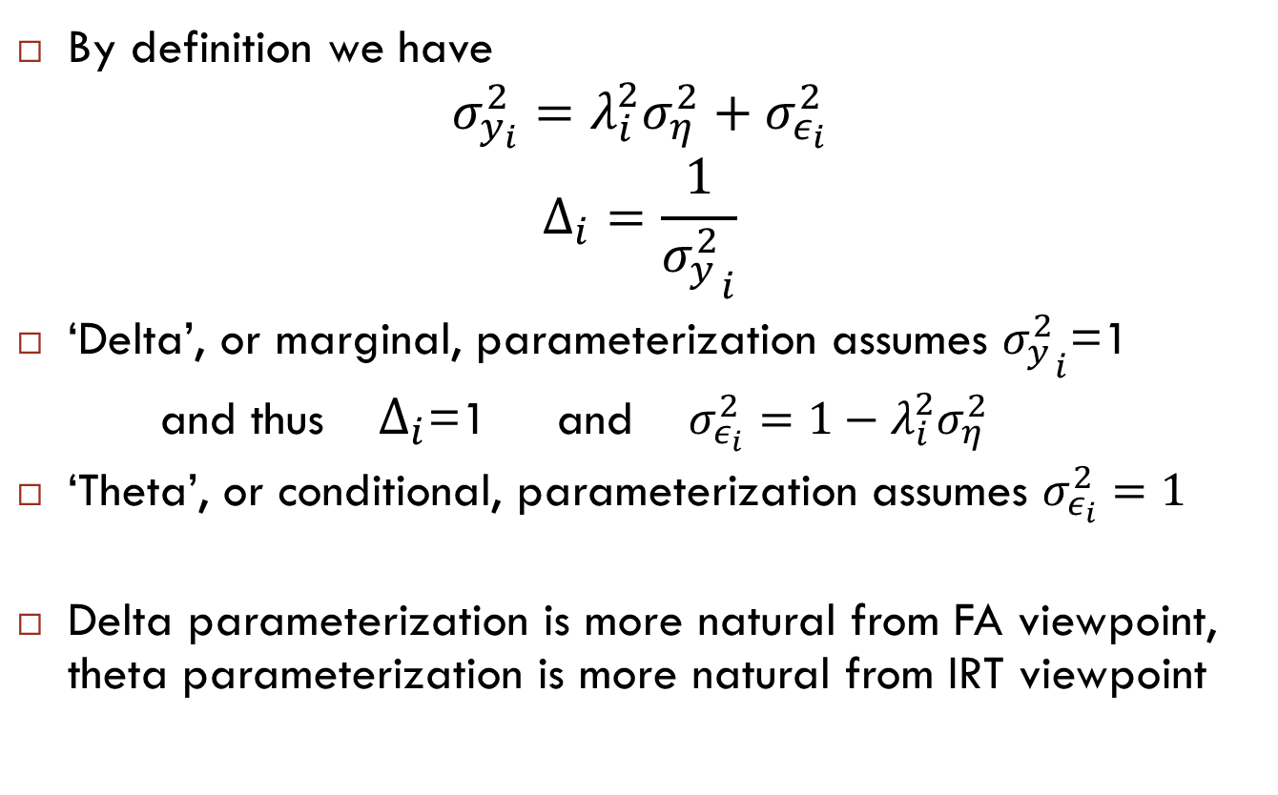
Identifying scale of underlying latent variable
By definition we have
$$σ_{y_{i}}^{2}=λ_{i}^{2}σ_{η}^{2}+σ_{ε_{i}}^{2}$$
$$Δ_{i}=\frac{1}{{σ_{y}^{2}}_{i}}$$
‘Delta’, or marginal, parameterization assumes ${σ_{y}^{2}}_{i}$=1
and thus $Δ_{i}$=1 and $σ_{ε_{i}}^{2}=1−λ_{i}^{2}σ_{η}^{2}$
‘Theta’, or conditional, parameterization assumes $σ_{ε_{i}}^{2}=1$
Delta parameterization is more natural from FA viewpoint, theta parameterization is more natural from IRT viewpoint

Slide 11
Categorical FA vs. IRT
Correspondence: Aim is to model association between LV and observed item responses
Historical differences:
Estimation:
IRT: maximum likelihood (ML)
Estimates model parameters in one step
Not available for ordered categorical indicators in lavaan
Similar to a logistic regression approach
FA: diagonally weighted least squares (DWLS)
Estimates tetra- or polychoric correlation matrix, performs continuous variable CFA on that matrix
Only option for ordered categorical indicators in lavaan
Similar to a probit regression approach
Parameterization:
Delta parameterization in FA, theta parameterization in IRT
In IRT, latent trait often scaled by assuming mean 0 and variance 1
In CFA, latent trait often scaled by setting loading of first item to 1
What we call loadings and thresholds in CFA, we call discrimination and difficulty parameters in IRT

Slide 12
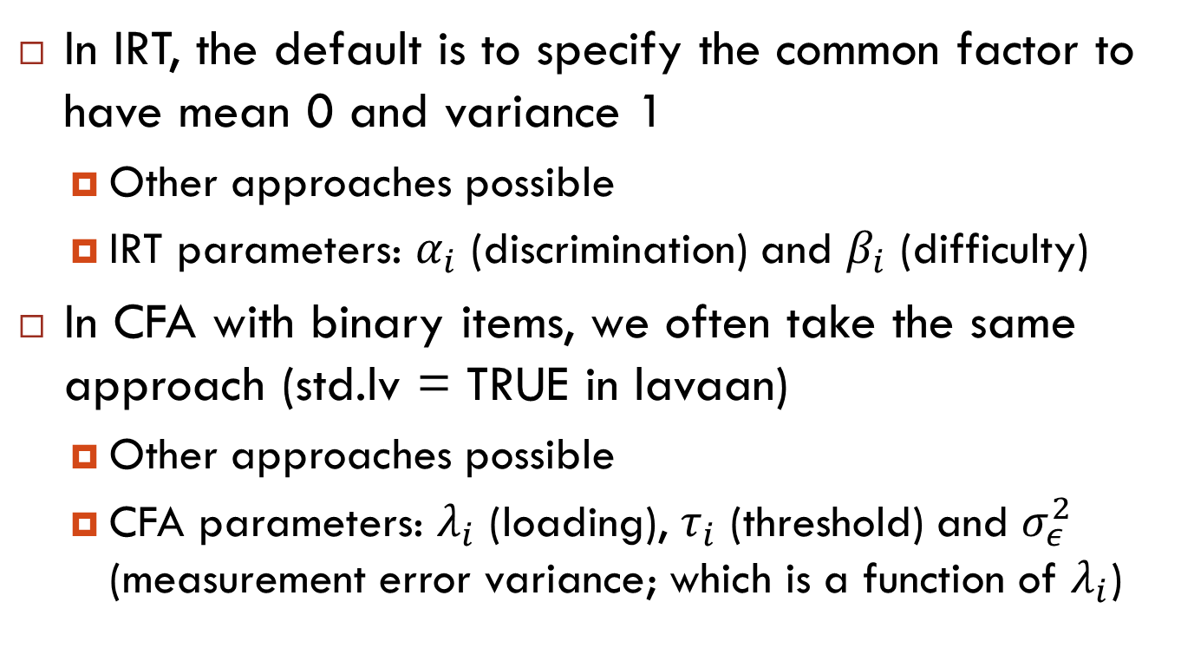
Scale of common factor: CFA (LS) vs. IRT (ML)
In IRT, the default is to specify the common factor to have mean 0 and variance 1
Other approaches possible
IRT parameters: $α_{i}$ (discrimination) and $β_{i}$ (difficulty)
In CFA with binary items, we often take the same approach (std.lv = TRUE in lavaan)
Other approaches possible
CFA parameters: $λ_{i}$ (loading), $τ_{i}$ (threshold) and $σ_{ε}^{2}$ (measurement error variance; which is a function of $λ_{i}$)

Slide 13
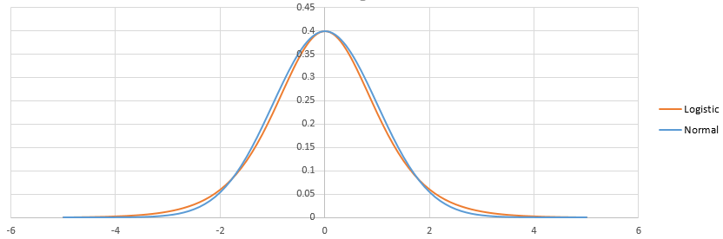
ML (IRT) vs LS (FA) - Logistic vs probit
Logistic model (employed in ML estimation) assumes binomial error distribution
Probit model (employed in LS-type estimation) assumes Gaussian error distribution
Their probability distributions have very similar shapes:

Slide 14
Logistic vs probit
To get the logit and the probit to align, the logit's slope must be ≈1.7 times the slope value for the probit
Philosophical differences:
Logistic model assumes the common factor to be directly connected to the probability of a correct response
Note: in line with ML estimation, where model is estimated in one step
Probit model assumes the dichotomous response resulted from a dichotomization of an underlying normally distributed variable
Note: in line with LS-type estimation, where we estimate tetrachoric (polychoric) correlation matrix, and then fit a CFA for continuous variables to that correlation matrix

Slide 15
Confusing?
Many scalings, but interpretation is all alike:
Values of slope, factor loading, discrimination parameters (λ, a, α) increase together
Higher values: better discrimination, stronger indicator, less measurement error
Values of threshold, difficulty (τ, b, β) increase together
Higher values: more difficult (need higher value of latent trait for correct (or affirmative) response)
Can compute any parameterization from any other parameterization (but may lead to headache)
Most important:
Be aware of existence of different parameterizations
Do not directly compare results from different estimators and parameterizations when interpreting models

Slide 16
Examples and exercises
Example 6.2 – Part II
Exercise 6.2 a-d

Slide 17
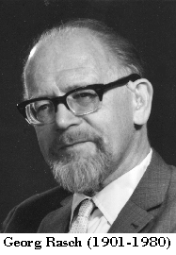
IRT models
Binary items:
1PL, or Rasch model (loadings equal, thresholds free)
2PL (loadings free, thresholds free)
…
Polytomous items:
Partial credit model (loadings equal, thresholds free)
Graded response model (loadings free, thresholds free)
…
No Rasch, no good!

Slide 18
No Rasch, no good?
Often in psychology, we want to use the test score: the (unweighted) sum of item scores
Easy to calculate, you need no IRT or SEM software to estimate it
In the Rasch model, all item loadings are equal, so all item scores contribute equally to estimation of the latent trait
Test score is ‘sufficient statistic’ for eta (latent trait)
"no other statistic that can be calculated from the same sample provides any additional information as to the value of the parameter"
Well-fitting Rasch model: test score contains all information about latent trait

Slide 19
Examples and exercises
Example 6.2 – Part III
Exercise 6.2 e

Slide 20
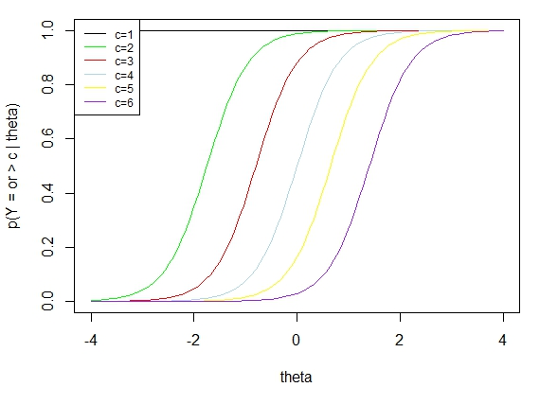
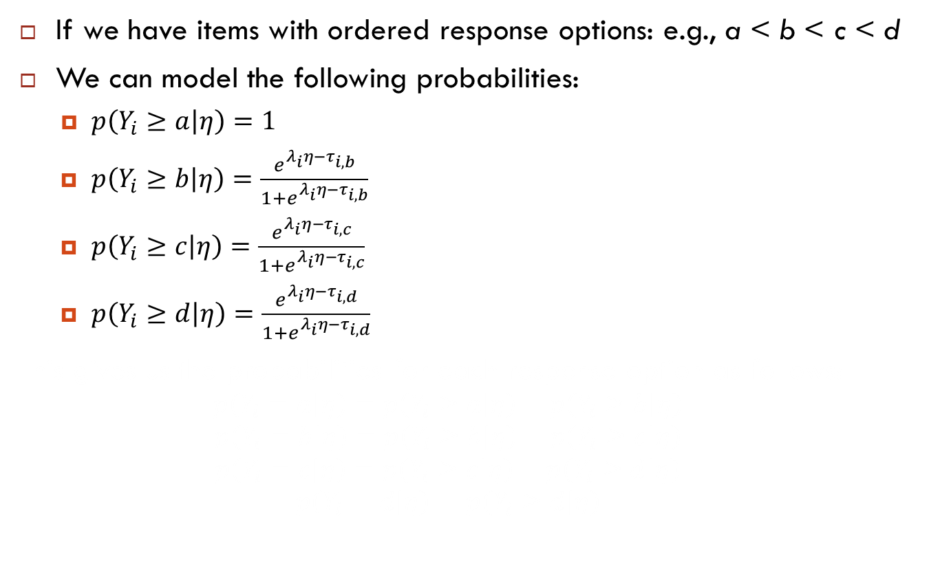
Ordinal responses
If we have items with ordered response options: e.g., a < b < c < d
We can model the following probabilities:
$p\left(Y_{i}≥a | η\right)=1$
$p\left(Y_{i}≥b | η\right)=\frac{e^{λ_{i}η−τ_{i,b}}}{1+e^{λ_{i}η−τ_{i,b}}}$
$p\left(Y_{i}≥c | η\right)=\frac{e^{λ_{i}η−τ_{i,c}}}{1+e^{λ_{i}η−τ_{i,c}}}$
$p\left(Y_{i}≥d | η\right)=\frac{e^{λ_{i}η−τ_{i,d}}}{1+e^{λ_{i}η−τ_{i,d}}}$
This gives us the probabilities for each response option as follows:
$$p\left(Y_{i}=a | η\right)=p\left(Y_{i}≥a | η\right)−p\left(Y_{i}≥b | η\right)$$
$$p\left(Y_{i}=b | η\right)=p\left(Y_{i}≥b | η\right)−p\left(Y_{i}≥c | η\right)$$
$$p\left(Y_{i}=c | η\right)=p\left(Y_{i}≥c | η\right)−p\left(Y_{i}≥d | η\right)$$
$$p\left(Y_{i}=d | η\right)=p\left(Y_{i}≥d | η\right)$$

Slide 21
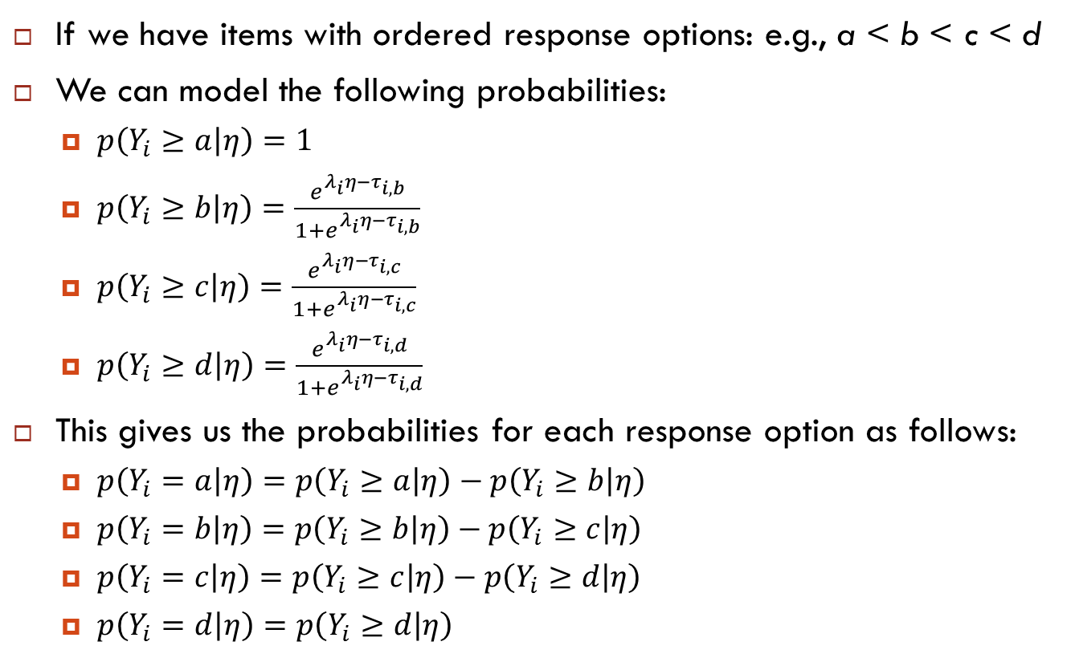
Ordinal responses
If we have items with ordered response options: e.g., a < b < c < d
We can model the following probabilities:
$p\left(Y_{i}≥a | η\right)=1$
$p\left(Y_{i}≥b | η\right)=\frac{e^{λ_{i}η−τ_{i,b}}}{1+e^{λ_{i}η−τ_{i,b}}}$
$p\left(Y_{i}≥c | η\right)=\frac{e^{λ_{i}η−τ_{i,c}}}{1+e^{λ_{i}η−τ_{i,c}}}$
$p\left(Y_{i}≥d | η\right)=\frac{e^{λ_{i}η−τ_{i,d}}}{1+e^{λ_{i}η−τ_{i,d}}}$
This gives us the probabilities for each response option as follows:
$p\left(Y_{i}=a | η\right)=p\left(Y_{i}≥a | η\right)−p\left(Y_{i}≥b | η\right)$
$p\left(Y_{i}=b | η\right)=p\left(Y_{i}≥b | η\right)−p\left(Y_{i}≥c | η\right)$
$p\left(Y_{i}=c | η\right)=p\left(Y_{i}≥c | η\right)−p\left(Y_{i}≥d | η\right)$
$p\left(Y_{i}=d | η\right)=p\left(Y_{i}≥d | η\right)$

Slide 22
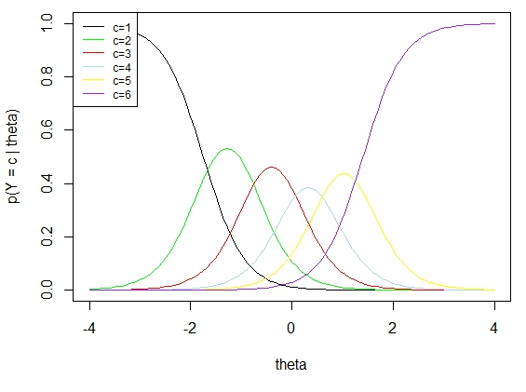
Ordinal responses
If we have items with ordered response options: e.g., a < b < c < d
We can model the following probabilities:
$p\left(Y_{i}≥a | η\right)=1$
$p\left(Y_{i}≥b | η\right)=\frac{e^{λ_{i}η−τ_{i,b}}}{1+e^{λ_{i}η−τ_{i,b}}}$
$p\left(Y_{i}≥c | η\right)=\frac{e^{λ_{i}η−τ_{i,c}}}{1+e^{λ_{i}η−τ_{i,c}}}$
$p\left(Y_{i}≥d | η\right)=\frac{e^{λ_{i}η−τ_{i,d}}}{1+e^{λ_{i}η−τ_{i,d}}}$
This gives us the probabilities for each response option as follows:
$p\left(Y_{i}=a | η\right)=p\left(Y_{i}≥a | η\right)−p\left(Y_{i}≥b | η\right)$
$p\left(Y_{i}=b | η\right)=p\left(Y_{i}≥b | η\right)−p\left(Y_{i}≥c | η\right)$
$p\left(Y_{i}=c | η\right)=p\left(Y_{i}≥c | η\right)−p\left(Y_{i}≥d | η\right)$
$p\left(Y_{i}=d | η\right)=p\left(Y_{i}≥d | η\right)$

Slide 23
Ordinal responses
For every item with k ordered categories, we need to estimate one loading, and k-1 thresholds
In lavaan, we use the same approach as with dichotomous data: use ‘ordered = ….’ argument
For every item declared ordered, lavaan checks number of categories, and estimates k-1 thresholds

Slide 24
Ordered-categorical responses
Partial credit model is the Rasch (1PL) model generalized to polytomous items
Same loadings for all items
Freely estimates thresholds for all categories and items
Graded response model is the 2PL model generalized to polytomous items
Freely estimates loadings for all items
Freely estimates thresholds for all categories and items
Note: Unlike in Rasch model, in PCM test score is not a sufficient statistic (does not contain all information about) for the latent trait (eta)

Slide 25
Examples and exercises
Example 6.2 – Part IV
Additional Exercise: HADS

